Slide 1

Monthly Market Mantra
February, 2026
Monthly Market Update January, 2026

Slide 2
Market Overview
India
RBI keeps policy rate unchanged at 5.25%, maintains neutral stance, and projects 7.4% GDP growth
Union budget set fiscal deficit target of 4.3% of GDP, increased Government budget allocation to INR 12.2 lakh crore, up by 10% y-o-y
India – Europe signed free trade agreement, expect to boost exports
Other International Market
India- US trade deal, cuts US tariffs on Indian goods to 18%
Japanese yen weakened to ~153-155 per USD, driven by election uncertainty and stimulus expectations
US–Iran tensions remain elevated amid ongoing nuclear and geopolitical differences
U.S.
Fed left interest rate unchanged in Jan-26, in line with street expectations
US headline CPI remained to 2.7% in Dec-25
US president signed $1.2 tn budget, ending partial government shutdown
International
Gold touched $5,500 per ounce & Silver $121.8 per ounce in Jan-26
Brent crude touched ~USD 71/bbl but eased later, on escalating tensions between US-Iran
Global sentiment stayed cautious, rising commodity prices and mixed economic data and geopolitical tensions
Source: Moneycontrol, Bloomberg, CNBC, Trading economics
As on 6th February 2026
www.shriramamc.in

Slide 3
Indian markets underperformed in Jan-26
All indices were down in 1M period
Nifty midcap 50 outperformed in 6M and 1Y period
Disclaimer: Past performance may or may not sustain in the future
Data Source: NiftyIndices.com
Data as on 30th January 2026
www.shriramamc.in

Slide 4
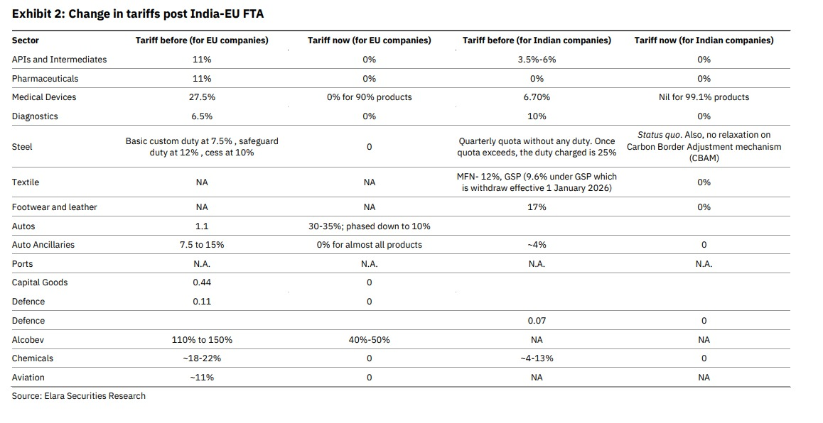
India – Europe free trade agreement
Change in tariffs post FTA
India – Europe FTA boosts growth and revenue prospects for Indian markets
Source: Elara Capital research
www.shriramamc.in

Slide 5
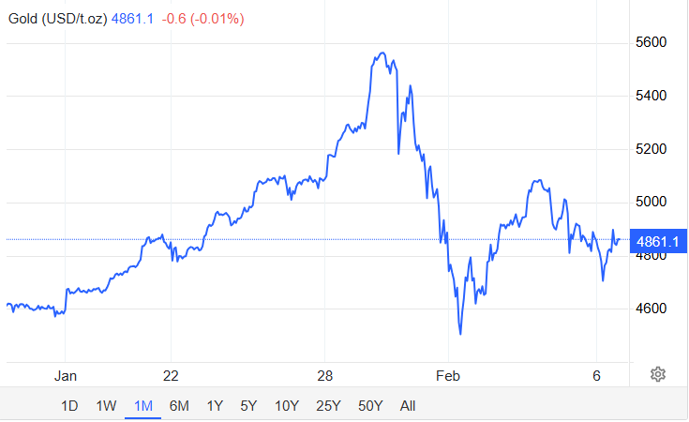
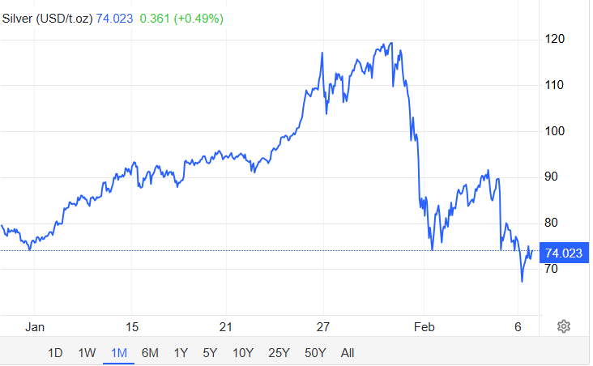
Gold & silver correct over 1M period
Gold prices rose >$5,000 per ounce in Jan-26, amid global tensions & softer dollar
Silver prices rose >$119.9/t.oz per ounce in Jan-26, on stronger industrial demand
Source: Trading Economics
Data as on 6th February
www.shriramamc.in

Slide 6
Global Markets (MSCI) – Geopolitical Impact
Indian market underperformed in 1M period due to rising commodities and continued FII selling
US market was up by 1% in 1M period on back of improved earnings and supportive fund flows
Brazil market grew in 1M period on the back of stable commodity prices & strong FII flows
Disclaimer: Past performance may or may not sustain in the future
Data Source: MSCI.com
As on 30th January 2026
www.shriramamc.in

Slide 7
Sector Indices performance – Jan-26
Period | Nifty Auto | Nifty Bank | Nifty Consumer Durables | Nifty CPSE | Nifty FMCG | Nifty Pharma | Nifty IT | Nifty Metal | Nifty Oil & Gas | Nifty Realty | Nifty Energy | Nifty Commodities
1M | -5% | 1% | -6% | 7% | -8% | -4% | 0% | 6% | -4% | -11% | -1% | 1%
3M | 0% | 4% | -11% | 3% | -9% | -2% | 7% | 11% | -2% | -17% | -3% | 3%
6M | 13% | 7% | -11% | 6% | -7% | -6% | 7% | 26% | 3% | -15% | -1% | 9%
1Y | 19% | 22% | -6% | 14% | -8% | 1% | -10% | 43% | 13% | -13% | 6% | 21%
Top Performer :CPSE & Metals
Top Laggards: Nifty Realty, FMCG, Consumer durables & Auto
Data Source: NiftyIndices.com
Data as on 30th January,2026
Disclaimer: Past performance may or may not sustain in the future
www.shriramamc.in

Slide 8
Sectors update
Sectors | Key Developments | Valuation | Our View
Consumer Durables | Q3FY26 delivered strong 3QFY26 growth, with aggregate revenue up ~22% YoY and EBITDA/PAT rising ~27%/~30% YoY, supported by robust demand. C&W outlook remains upbeat from infrastructure, power, and real estate, while RAC demand recovers on new BEE-rating norms, though elevated inventories and cost pressures persist | Trailing P/BV near +1SD | Underweight
Oil & Gas | Brent crude oil prices, after reaching $71/bbl recently, have now corrected. Natural gas prices are also softening, benefiting gas distribution companies. The Union Budget 2026-27 maintained excise duties on petrol, diesel, and domestic LPG, supporting OMCs | Trailing P/BV just above 5-yr average | Stock Specific
Auto | In Q3FY26, auto OEMs and ancillaries saw ~20–25% revenue growth with strong profits. Labour codes and input costs had minimal impact. Union Budget 2026–27 measures, including rare earth corridors, REPM scheme, higher PLI, and PM E‑DRIVE, support the sector outlook | Trailing P/BV trading above 5 yr average | Stock specific bottom up
FMCG | Q3FY26, FMCG companies saw resilient consumption demand despite macro uncertainties. Revenue growth remained steady, supported by broad-based urban and rural demand, though price-led volume growth varied across categories. Profitability stayed stable as firms managed input costs through pricing and efficiency measures. | Trailing P/BV just below 5-yr average SD | Stock specific
Disclaimer: Sectors specific views mentioned herein are for Information purpose only, the Fund may or may not hold any present or future positions in these sectors
www.shriramamc.in

Slide 9
Sectors update
Sectors | Key Developments | Valuation | Our View
Banks | Q3 FY26 earnings highlight continued strength across financial services, including banks, NBFCs, life insurers, and AMCs. Credit growth was robust, driven by retail, MSME, NBFC, and corporate demand, alongside early industrial recovery, while deposit growth lagged amid competition. RBI liquidity support remains, though the recent STT hike on F&O may weigh on capital market–linked stocks | Trailing P/BV < 5yr avg SD | Overweight
Metals | In Q3FY26, ferrous companies saw healthy volume growth (12% YoY, 6% QoQ) but EBITDA/t fell due to weaker steel prices after the lapse of provisional safeguard duty. Non-ferrous players mostly reported earnings beats on strong pricing, with aluminum, zinc, and copper at elevated levels. Cost pressures remain manageable, though global trade tensions and metal price volatility are key risks going forward | Trailing P/BV ~ 5-yr >+2× SD | Stock specific
CPSE | 3QFY26 capital goods and defense saw YoY profit growth with strong orders. Margins were mixed due to commodity costs, partly offset by pass-throughs. Union Budget 2026–27 allocated a record INR 7.85 lakh crore to defense, including INR2.19 lakh crore for capital expenditure, the India-EU FTA expected to boost international opportunities | Trailing P/BV ~ 5-yr near +1× SD | Stock specific
Disclaimer: Sectors specific views mentioned herein are for Information purpose only, the Fund may or may not hold any present or future positions in these sectors
www.shriramamc.in

Slide 10
Sectors update
Sectors | Key Developments | ValuationFY25 | Our View
IT | In Q3FY26, IT services delivered better-than-feared earnings with stable margins and modest revenue growth, while AI adoption gains momentum. Union Budget 2026–27 supported the sector via higher safe-harbour limits, unified margins, faster APA, and a tax holiday for cloud and data centres, boosting investment and tax certainty | Trailing P/BV at 5-yr SD | Overweight
Pharma | In Q3 FY26, India’s pharma sector saw broad growth, healthy margins, and ongoing pipeline and international focus. Union Budget measures like Biopharma SHAKTI and integrated medical hubs support long-term healthcare, pharma innovation, and advanced manufacturing | Trailing P/BV > 5-yr SD | Stock specific
Chemicals | Agriculture and chemical markets remain under pressure, with oversupply in most segments, weak crop prices, and muted global demand. Temporary upticks in certain chemicals were driven by maintenance outages and stocking ahead of Chinese holidays, while exports show mixed trends | Trailing P/BV Fairly Valued | Stock specific
Disclaimer: Sectors specific views mentioned herein are for Information purpose only, the Fund may or may not hold any present or future positions in these sectors
www.shriramamc.in

Slide 11
DIIs support amid FII selling -Jan-26
DIIs kept Indian stocks steady as FIIs continue to sell
Source: Moneycontrol.com
DII & FII data as on 30th Jan-26
www.shriramamc.in

Slide 12
Global Update
www.shriramamc.in

Slide 13
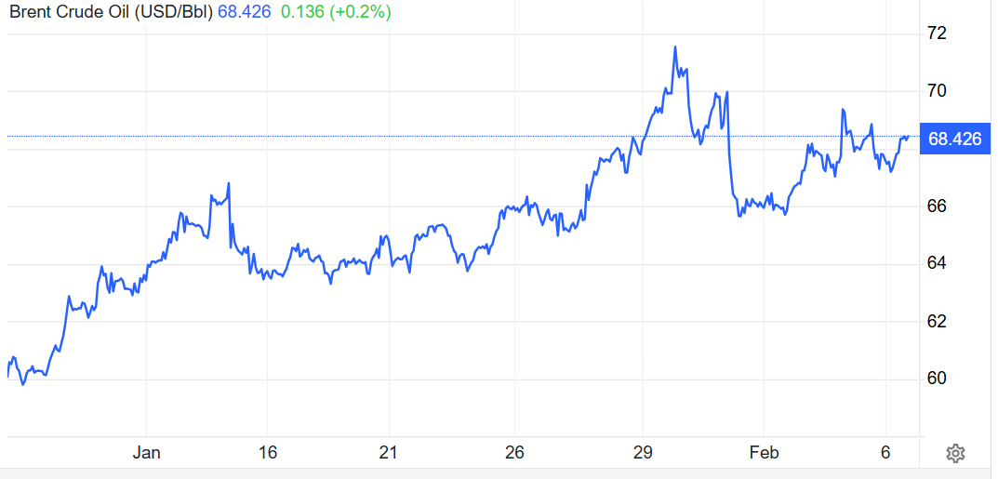

US-Iran tensions escalate global crude oil prices
Brent crude rose to around $71 per barrel on 29th Jan-26; as US–Iran tensions increased geopolitical risk and supply concerns
Source: Trading economics
Data as on 6th Februaray, 2026
www.shriramamc.in

Slide 14
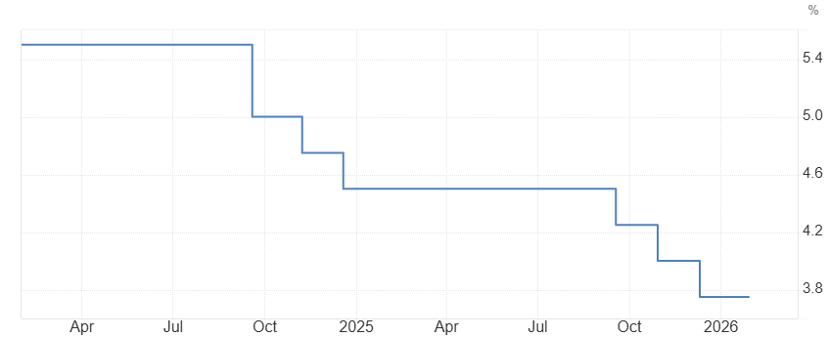
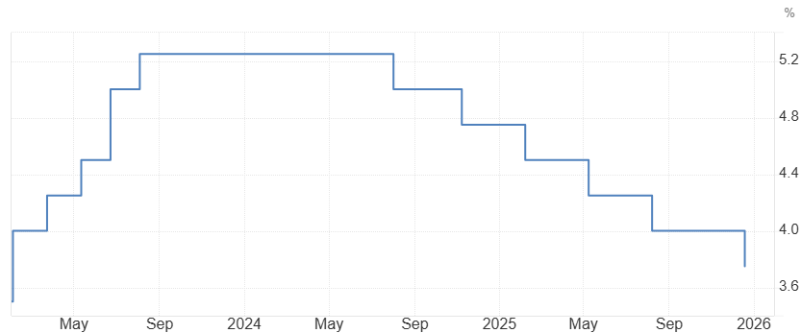
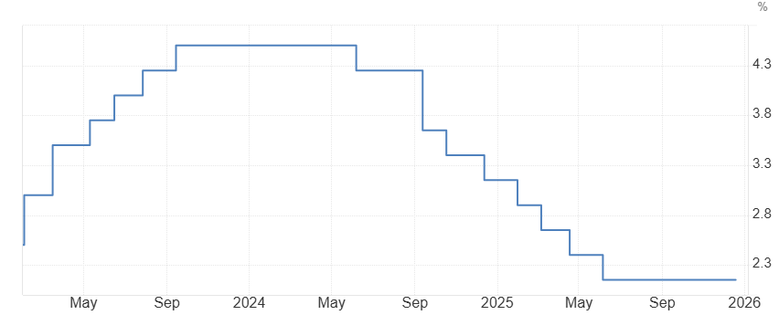
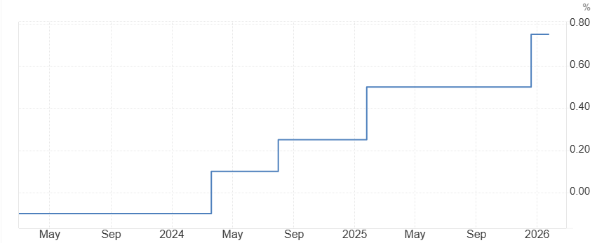
Global interest rate
U.S. (unchanged in Jan-26)
UK (Dec-25)
EU (Dec-25)
Japan (unchanged in Jan-26)
Source: Trading Economics
www.shriramamc.in

Slide 15
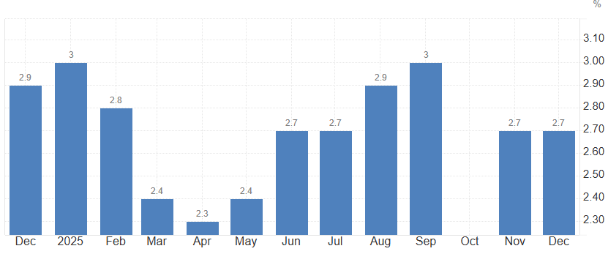
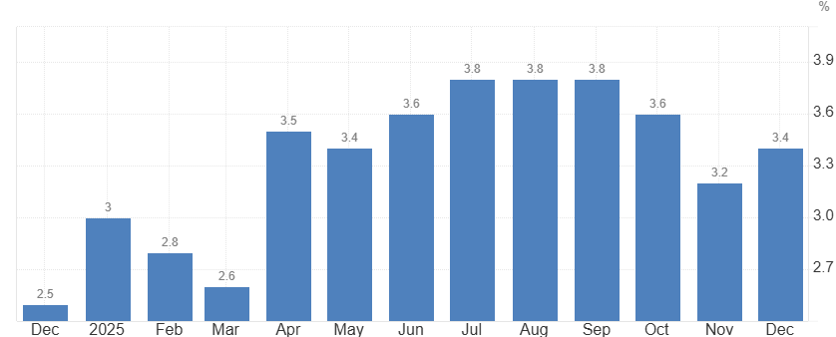
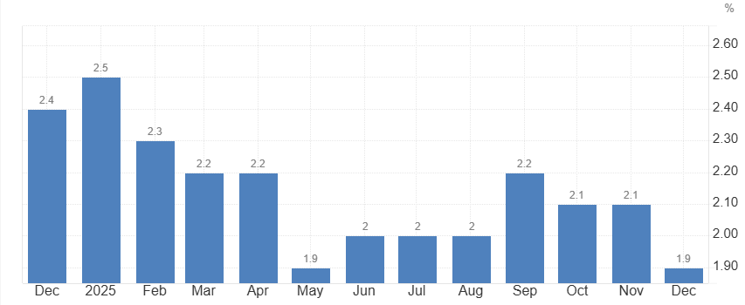
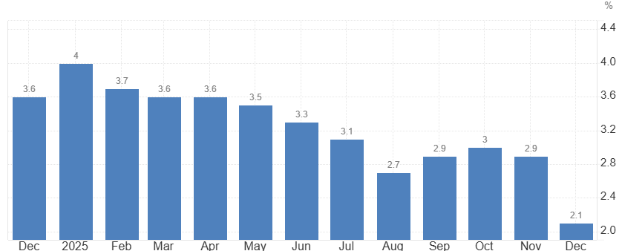
Global inflation trends remain mixed
U.S
UK
EU
Japan
Source: Trading Economics
www.shriramamc.in

Slide 16

Domestic Update
www.shriramamc.in

Slide 17
GST collections stay firm
GST collections up 6.2% YoY to ~Rs 1.93L cr in Jan-26, led by consumption and strong import revenues
Source: Gst.gov.in
www.shriramamc.in

Slide 18
PMI : Service Strengthens
India’s Manufacturing PMI rose to 55.4 in Jan-26, due to rise in manufacturing activity
India’s Services PMI grew to 58.5 in Jan-26, on back of new orders
Source: Trading Economics
Data as on Jan-26
www.shriramamc.in

Slide 19
Outlook – Medium Term
Inflation
India’s CPI at 1.33% (Dec-25), tempered by GST rationalization
Liquidity
RBI advancing its Rs 1 lakh crore OMO purchases to stabilize the market liquidity
Interest rate
RBI keeps interest rate unchanged at 5.25%, continues neutral stance
Bond Markets
Equity Markets
India’s 10Y G-sec spiked to (~6.7%), ahead of RBI bond purchase and policy decision
Domestic equities may remain sideways as elevated commodity prices pressure margins despite increase in government capex
Fed left interest rate unchanged in Jan-26, as per street estimates
US 10Y note yield (4.24%), supported by Fed’s no change in interest rates
Global markets remain volatile amid rising Middle East and geopolitical tensions
US headline CPI at 2.7% (Dec-25), keeping disinflation gradual
Liquidity to remain sufficient amid rupee volatility
Source: Trading Economics, Investing.com, Money control, Federal reserve
www.shriramamc.in

Slide 20
Key Risks
Despite strong Q3FY26 earnings, elevated commodity prices continue to pressure margins
India–US bilateral trade deal finalized, but uncertainty remains around details beyond tariff reductions
Broad based sell off amid falling global metal prices and a stronger USD
Geopolitical or trade tensions affecting energy, exports, and investor sentiments
Mixed FII flows in India, with higher flows into other emerging markets posing a risk
Geopolitical and trade tensions, along with commodity price volatility, remain key concerns
www.shriramamc.in

Slide 21
Disclaimer
DISCLAIMER The views expressed herein are based on internal data, publicly available information and other sources believed to be reliable. Any calculations made are approximations, meant as guidelines only, which you must confirm before relying on them. This document has been prepared based on information, which is already available in publicly accessible media or developed through analysis of Shriram Mutual Fund. The recipient should note and understand that the information provided above may not contain all the material aspects relevant for making an investment decision and the security may or may not continue to form part of the scheme's portfolio in the future. Investors are advised to consult their investment advisor before making any investment decision in light of their risk appetite, investment goals, and horizon. The decision of the Investment Manager may not always be profitable; as such decisions are based on the prevailing market conditions and the understanding of the Investment Manager. Actual market movements may vary from the anticipated trends. Past performance may or may not be sustained in future. Sectors referred above are illustrative and not recommended by Shriram Mutual Fund (the Fund) / Shriram AMC. The Fund may or may not have any present or future positions in these sectors. Shriram AMC / the Fund is not guaranteeing / offering / communicating any indicative yield on investments made in the scheme(s). Neither Shriram AMC and the Fund nor any person connected with them, accepts any liability arising from the use of this document. The recipient(s) before acting on any information herein should make his/her/their own investigation and seek appropriate professional advice and shall alone be fully responsible / liable for any decision taken on the basis of information contained herein. Please refer to the Offer Documents/ Statement of Additional Information/ Key Information Memorandum of the Scheme before investing.
MUTUAL FUND INVESTMENTS ARE SUBJECT TO MARKET RISKS, READ ALL SCHEME RELATED DOCUMENTS CAREFULLY.
www.shriramamc.in

Slide 22
Thank You

